Slide 1
Emerging Pathogen Newsletter
The path to digitization

Slide 2
What is ep?
What is a Pathogen?
A pathogen is a micro-organism causing diseases to its host. Pathogens can be bacteria, viruses, fungi, or parasites
What is an Emerging Pathogen?
pathogens causing infections that have newly appeared in a population or have existed but are rapidly increasing in incidence or geographic range. Emerging pathogens are what will cause future pandemics

Slide 3
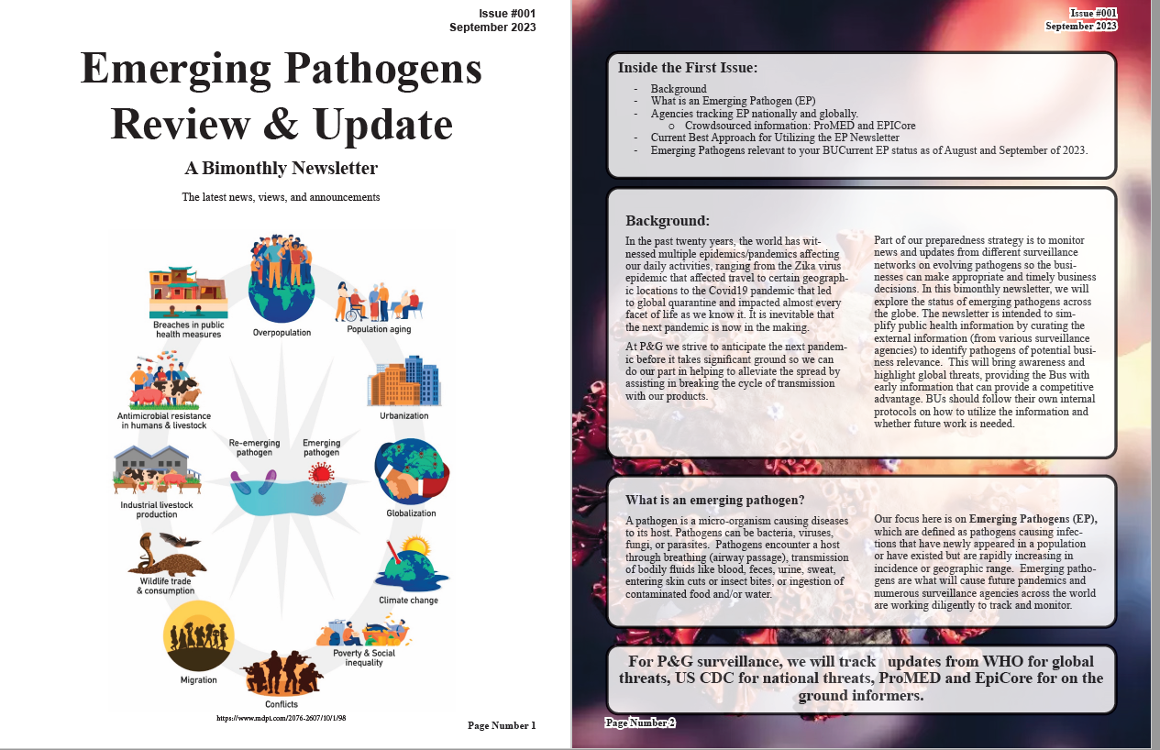
The Emerging Pathogen Newsletter
What:
Create a document capturing regional and global public health (PH) threats
Who:
Drafted and Edited manually by a Public Health (PH) Expert
Why:
prepare for next pandemic
Opportunity for Product Development
How:
We follow daily/weekly/monthly reports from major PH outlets

Slide 4
Problem Description?
Create an AI generated automatic system to carry out the following activities:
Generate a dataset of regional and global emerging pathogen news update using ProMedMail collected over the past month. - PROVIDED
Filter the dataset information to provide a summary table with most P&G relevant EP threats.
Generate a short description of each pathogen and why it should be of importance to P&G Business
Populate the summary table and the short pathogen description into a newsletter format automatically.

Slide 5
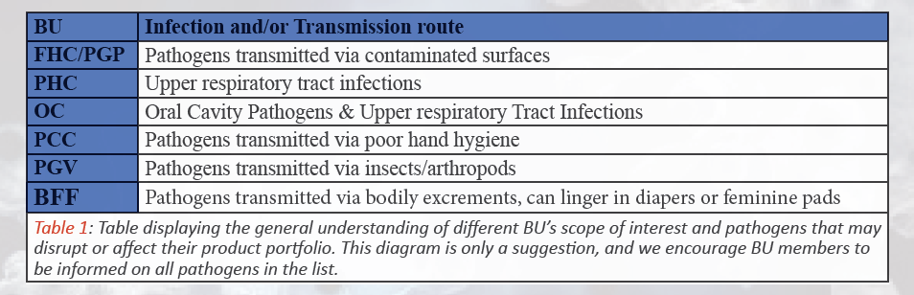
Criteria of Inclusion for Pathogens of Interest

Slide 6
Exclusion Criteria
Sexually transmitted diseases
Blood borne pathogens
Pathogens that only infect animals
Pathogens that only infect plants

Slide 7
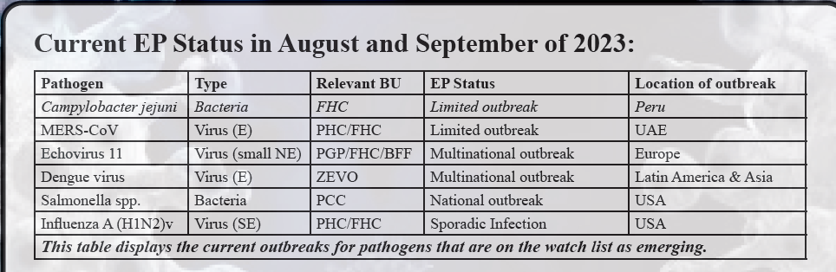
Example of the summary table

Slide 8
Scoring criteria
Type of outbreak | Explanation
Limited outbreak | Increase in incidence within reasonable limits (usually described in the text of the report)
Sporadic infection | A very few number of human infections occurred due to either animal contact or insect bite
Multinational outbreak | An outbreak expanding to more than one country
National outbreak | An outbreak affecting United States
Pandemic | An outbreak occurring in all parts of the world

Slide 9
Criteria for pathogen description
In the short summary to inform non-microbiologist of the relevant EP, aim to answer the following questions:
The name of the microorganism
The type of the microorganism (bacteria, virus, fungus etc.)
The mode of transmission of the microorganism

Slide 10
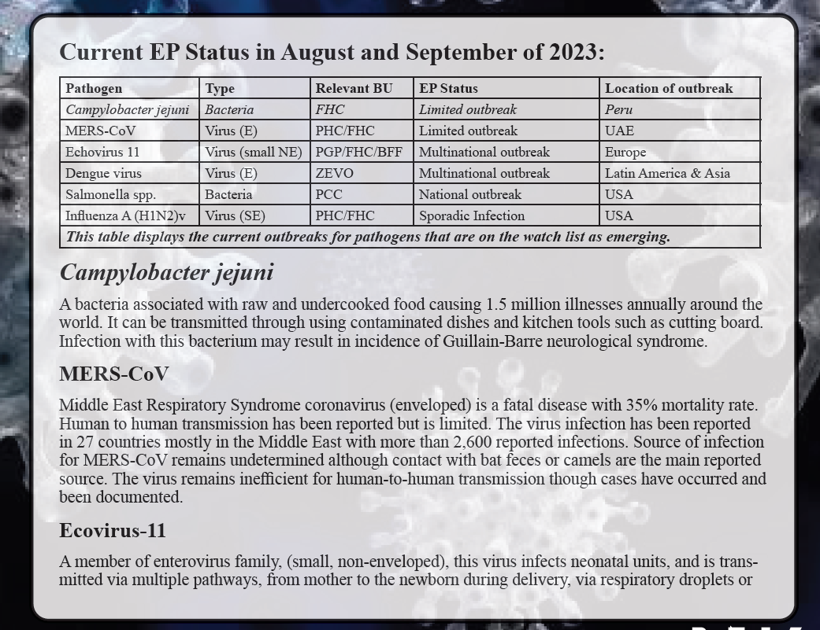
Example for pathogen description

